Slide 1
Why study logic design?
Obvious reasons
  this course is part of the CSCE requirements
  it is the implementation basis for all modern computing devices
    building large things from small components
    provide a model of how a computer works
More important reasons
  the inherent parallelism in hardware is often our first exposure to parallel computation
  it offers an interesting counterpoint to software design and is therefore
  useful in furthering our understanding of computation, in general
I - Design Concepts
Portions © Copyright 2009, S. Brown and Z Vranesic

Slide 2
What will we learn in this class?
The language of logic design
  Boolean algebra, logic minimization, state, timing, CAD tools
The concept of state in digital systems
  analogous to variables and program counters in software systems
How to specify/simulate/compile/realize our designs
  hardware description languages
  tools to simulate the workings of our designs
  logic compilers to synthesize the hardware blocks of our designs
  mapping onto programmable hardware
Contrast with software design
  sequential and parallel implementations
  specify algorithm as well as computing/storage resources it will use
I - Design Concepts
Portions © Copyright 2009, S. Brown and Z Vranesic

Slide 3
Applications of logic design
Conventional computer design
  CPUs, busses, peripherals
Networking and communications
  phones, modems, routers
Embedded products
  in cars, toys, appliances, entertainment devices
Scientific equipment
  testing, sensing, reporting
The world of computing is much much bigger than just PCs!
I - Design Concepts
Portions © Copyright 2009, S. Brown and Z Vranesic

Slide 4
A quick history lesson
1850: George Boole invents Boolean algebra
  maps logical propositions to symbols
  permits manipulation of logic statements using mathematics
1938: Claude Shannon links Boolean algebra to switches
  his Masters’ thesis
1945: John von Neumann develops the first stored program computer
  its switching elements are vacuum tubes (a big advance from relays)
1946: ENIAC . . . The world’s first completely electronic computer
  18,000 vacuum tubes
  several hundred multiplications per minute
1947: Shockley, Brittain, and Bardeen invent the transistor
  replaces vacuum tubes
  enable integration of multiple devices into one package
  gateway to modern electronics
I - Design Concepts
Portions © Copyright 2009, S. Brown and Z Vranesic

Slide 5
What is logic design?
What is design?
  given a specification of a problem, come up with a way of solving it choosing appropriately from a collection of available components
  while meeting some criteria for size, cost, power, beauty, elegance, etc.
What is logic design?
  determining the collection of digital logic components to perform a specified control and/or data manipulation and/or communication function and the interconnections between them
  which logic components to choose? – there are many implementation technologies (e.g., off-the-shelf fixed-function components, programmable devices, transistors on a chip, etc.)
  the design may need to be optimized and/or transformed to meet design constraints
I - Design Concepts
Portions © Copyright 2009, S. Brown and Z Vranesic

Slide 6
What is digital hardware?
Collection of devices that sense and/or control wires that carry a digital value (i.e., a physical quantity that can be interpreted
as a “0” or “1”)
  example: digital logic where voltage < 0.8v is a “0” and > 2.0v is a “1”
  example: pair of transmission wires where a “0” or “1” is distinguished by which wire has a higher voltage (differential)
  example: orientation of magnetization signifies a “0” or a “1”
Primitive digital hardware devices
  logic computation devices (sense and drive)
    are two wires both “1” - make another be “1” (AND)
    is at least one of two wires “1” - make another be “1” (OR)
    is a wire “1” - then make another be “0” (NOT)
  memory devices (store)
    store a value
    recall a previously stored value
sense
AND
drive
I - Design Concepts
Portions © Copyright 2009, S. Brown and Z Vranesic
sense

Slide 7
What is happening now in digital design?
Important trends in how industry does hardware design
  larger and larger designs
  shorter and shorter time to market
  cheaper and cheaper products
Scale
  pervasive use of computer-aided design tools over hand methods
  multiple levels of design representation
Time
  emphasis on abstract design representations
  programmable rather than fixed function components
  automatic synthesis techniques
  importance of sound design methodologies
Cost
  higher levels of integration
  use of simulation to debug designs
  simulate and verify before you build
I - Design Concepts
Portions © Copyright 2009, S. Brown and Z Vranesic

Slide 8
CSCE 32114: concepts/skills/abilities
Understanding the basics of logic design (concepts)
Understanding sound design methodologies (concepts)
Modern specification methods (concepts)
Familiarity with a full set of CAD tools (skills)
Realize digital designs in an implementation technology (skills)
Appreciation for the differences and similarities (abilities)
in hardware and software design
New ability: to accomplish the logic design task with the aid of computer-aided
design tools and map a problem description into an implementation with
programmable logic devices after validation via simulation and understanding
of the advantages/disadvantages as compared to a software implementation
I - Design Concepts
Portions © Copyright 2009, S. Brown and Z Vranesic

Slide 9
Figure 1.1. A silicon wafer (courtesy of Altera Corp.).
I - Design Concepts
Portions © Copyright 2009, S. Brown and Z Vranesic

Slide 10
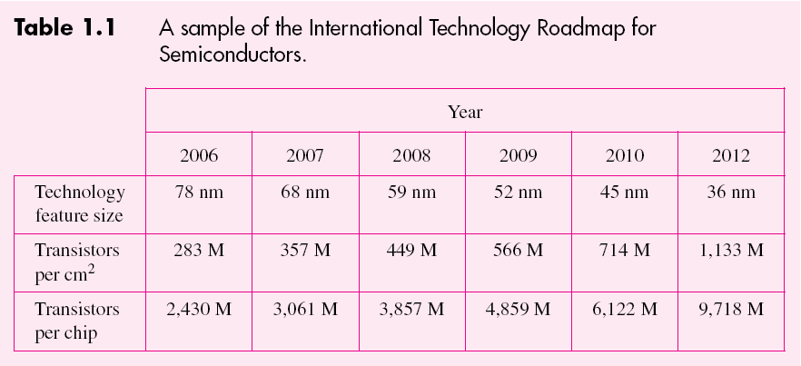
I - Design Concepts
Portions © Copyright 2009, S. Brown and Z Vranesic

Slide 11
Group of 8 logic cells
Memory block
Interconnection
wires
Figure 1.2. A field-programmable gate array chip
(courtesy of Altera Corp.).
I - Design Concepts
Portions © Copyright 2009, S. Brown and Z Vranesic

Slide 12
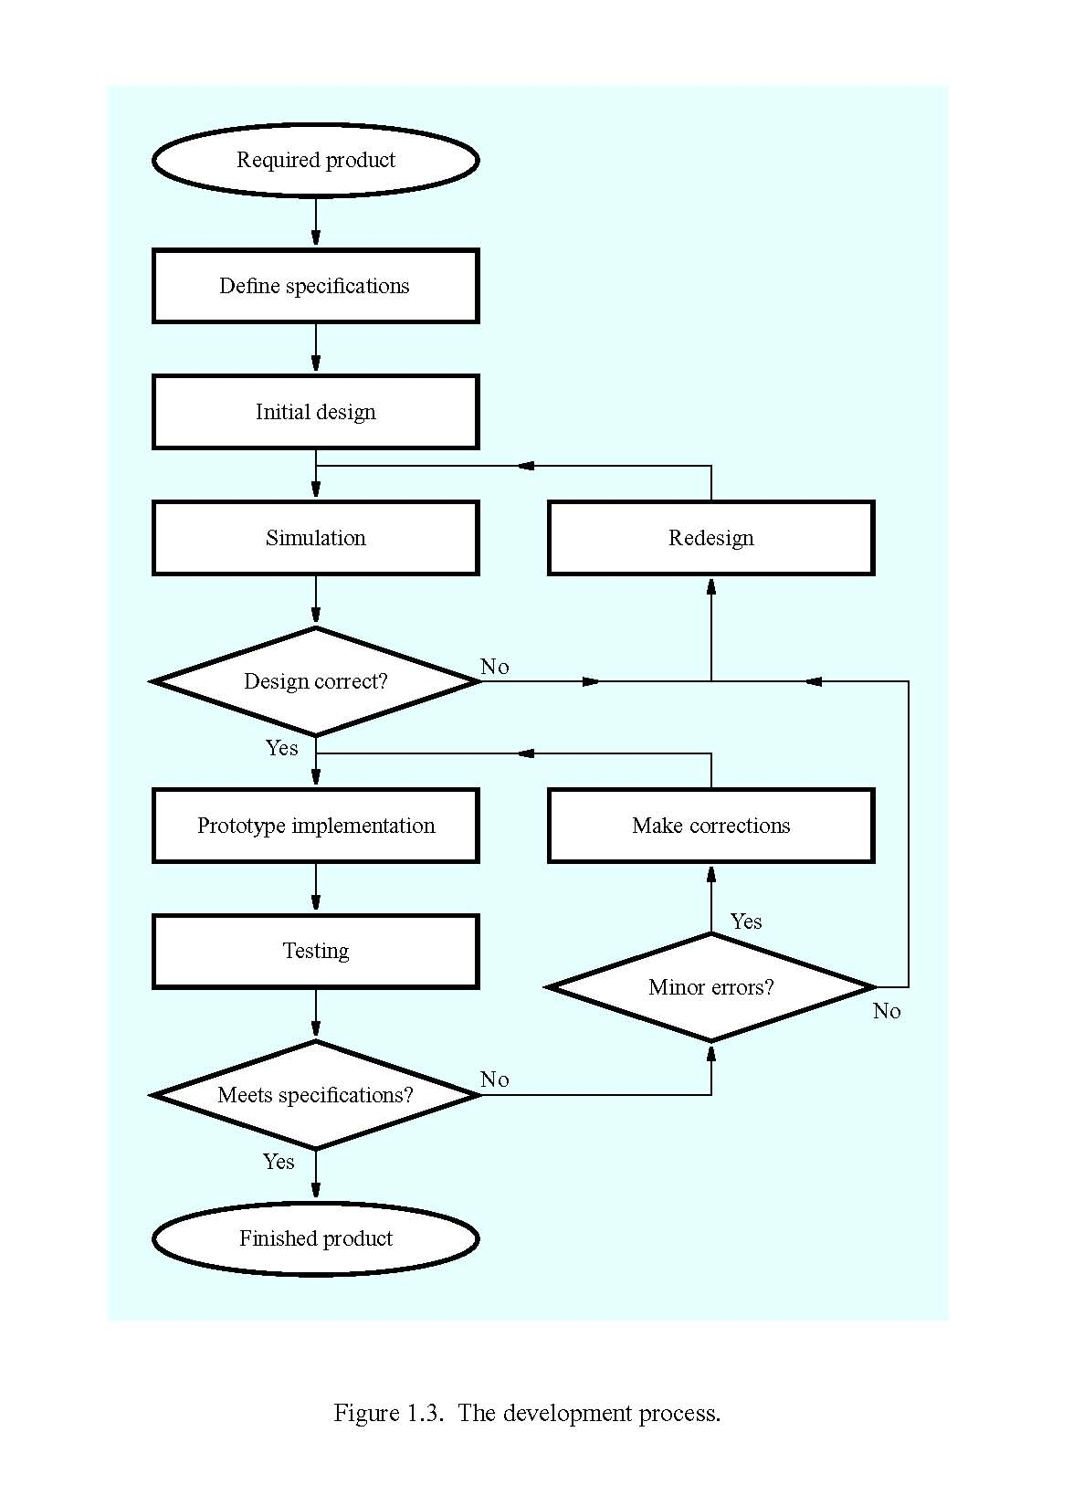
I - Design Concepts
Portions © Copyright 2009, S. Brown and Z Vranesic

Slide 13
Design concept
Initial design
Simulation
Redesign
No
Design correct?
Yes
Successful design
Figure 1.4. The basic design loop.
I - Design Concepts
Portions © Copyright 2009, S. Brown and Z Vranesic

Slide 14
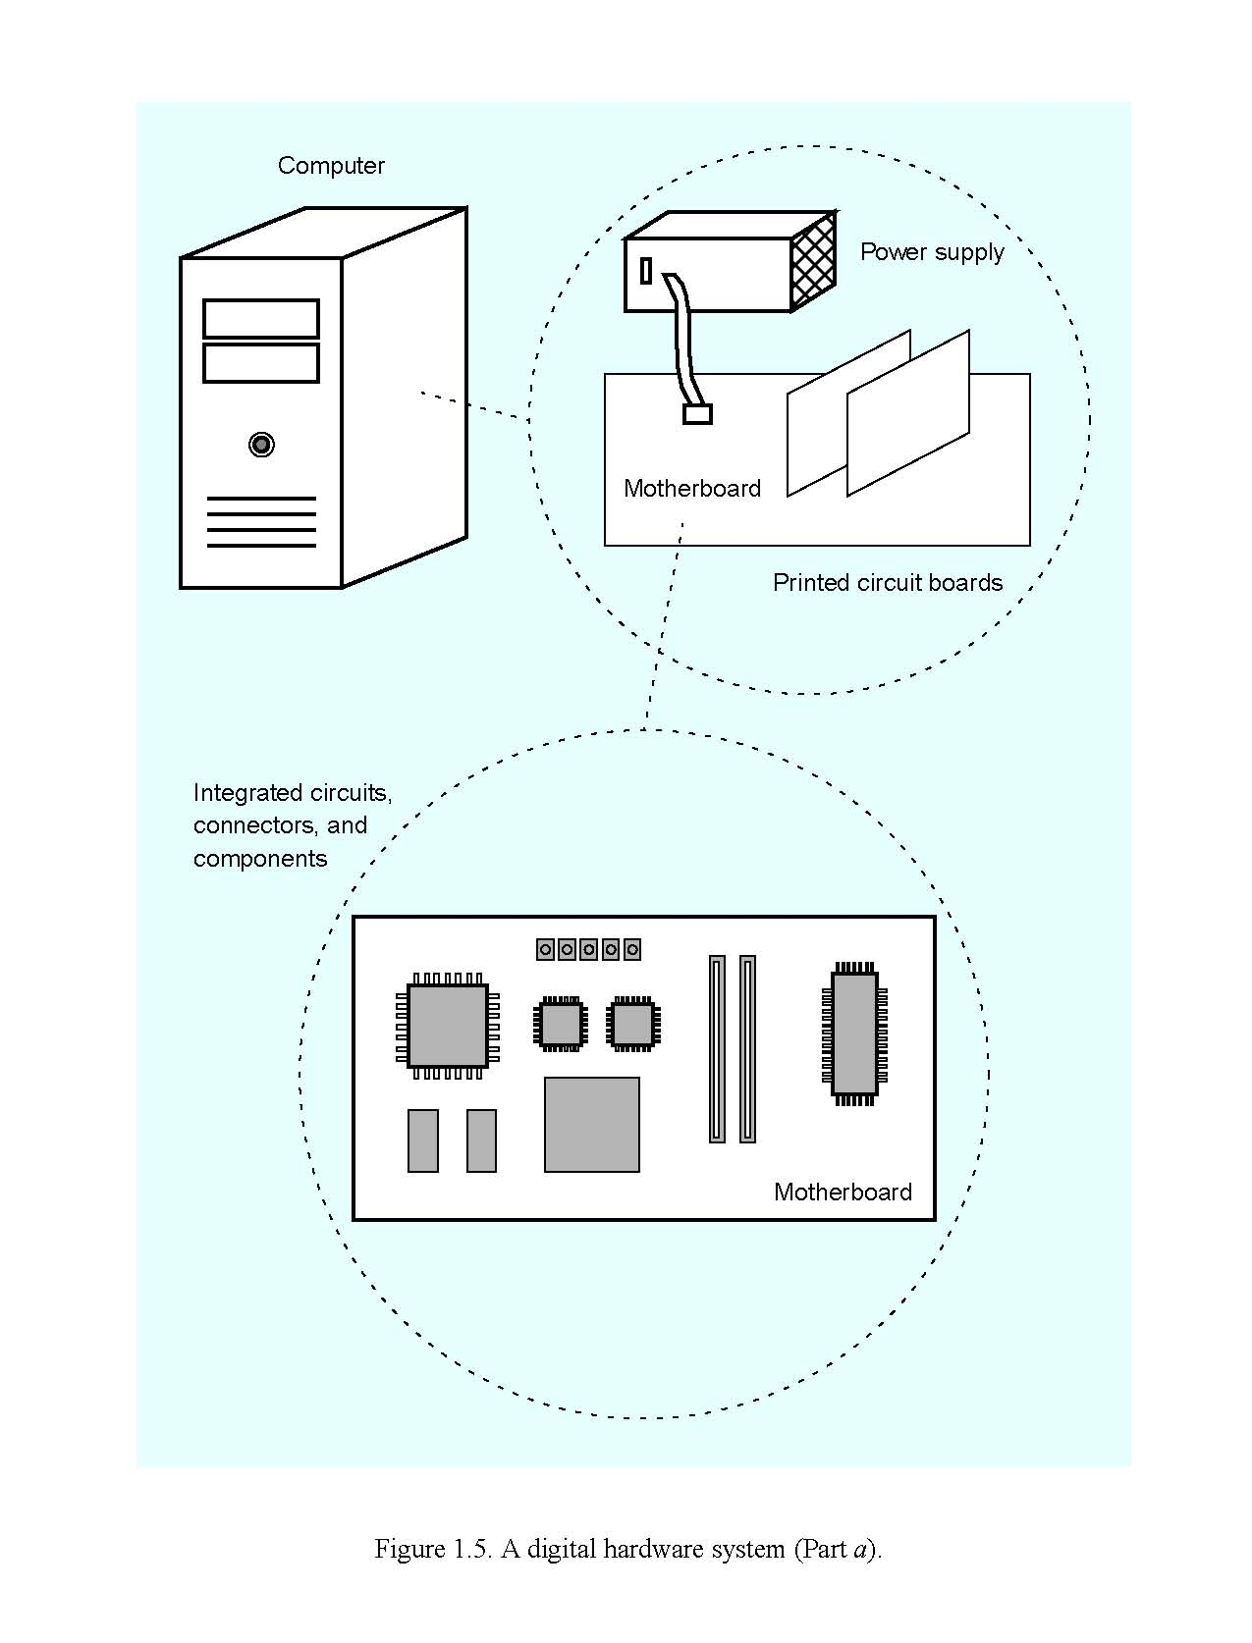
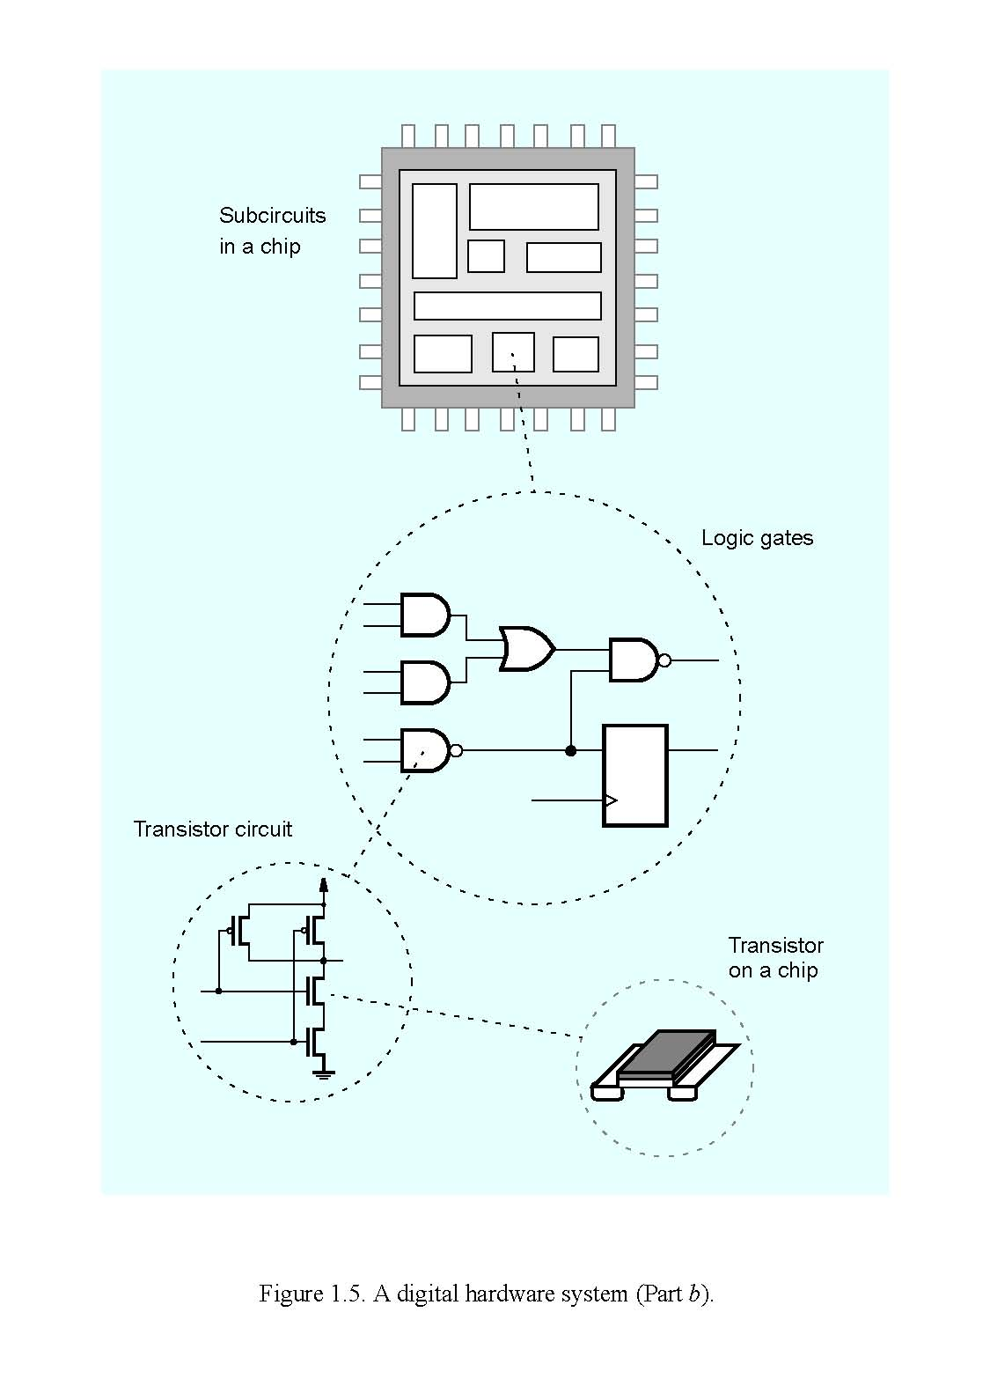
I - Design Concepts
Portions © Copyright 2009, S. Brown and Z Vranesic

Slide 15
Figure 1.6. A printed circuit board.
I - Design Concepts
Portions © Copyright 2009, S. Brown and Z Vranesic

Slide 16
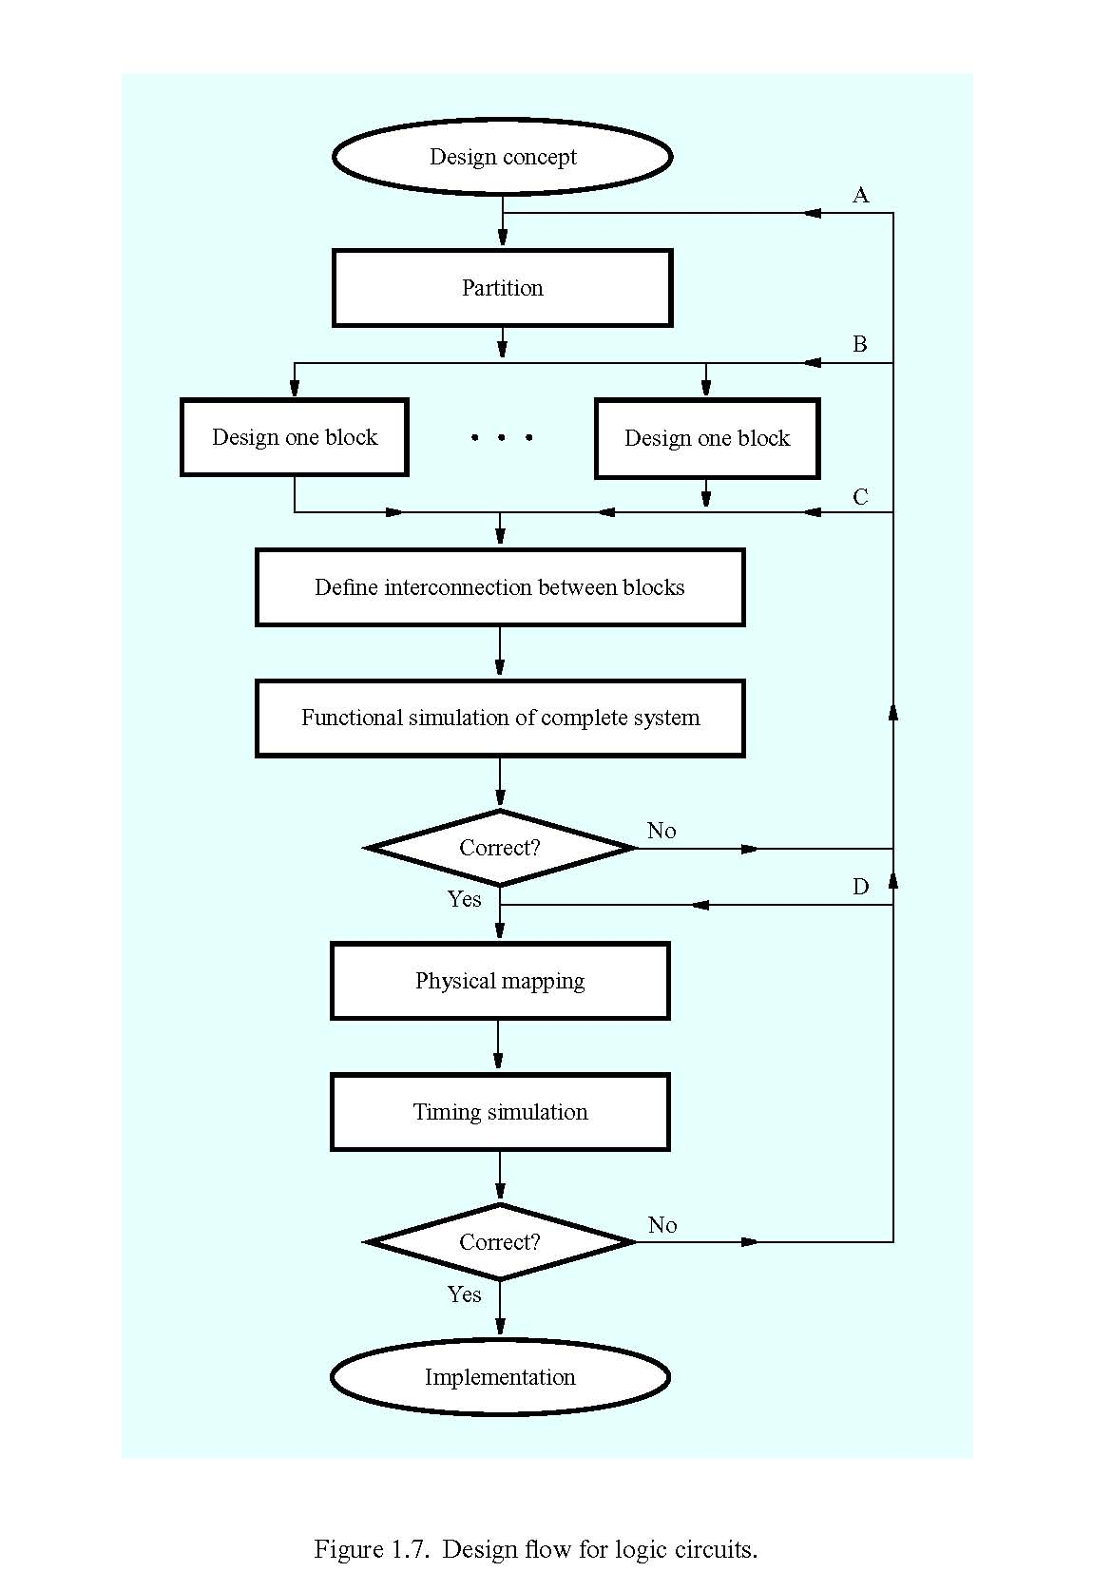
I - Design Concepts
Portions © Copyright 2009, S. Brown and Z Vranesic

Slide 17
Implementation
Build prototype
Testing
Modify prototype
Yes
No
Correct?
Minor errors?
Yes
No
Finished PCB
Go to A, B, C, or D in Figure 1.7
Figure 1.8. Completion of PCB development.
I - Design Concepts
Portions © Copyright 2009, S. Brown and Z Vranesic

Slide 18
Speed of MOS networks
What influences the speed of CMOS networks?
  charging and discharging of voltages on wires and gates of transistors
Capacitors hold charge
  capacitance is at gates of transistors and wire material
Resistors slow movement of electrons
  resistance mostly due to transistors
I - Design Concepts
Portions © Copyright 2009, S. Brown and Z Vranesic

Slide 19
Representation of digital designs
Physical devices (transistors, relays)
Switches
Truth tables
Boolean algebra
Gates
Waveforms
Finite state behavior
Register-transfer behavior
Concurrent abstract specifications
scope of CSCE 2114
I - Design Concepts
Portions © Copyright 2009, S. Brown and Z Vranesic

Slide 20
Digital vs. analog
Convenient to think of digital systems as having only
discrete, digital, input/output values
In reality, real electronic components exhibit
continuous, analog, behavior
Why do we make the digital abstraction anyway?
  switches operate this way
  easier to think about a small number of discrete values
Why does it work?
  does not propagate small errors in values
  always resets to 0 or 1
I - Design Concepts
Portions © Copyright 2009, S. Brown and Z Vranesic

Slide 21
Mapping from physical world to binary world
Technology State 0 State 1
Relay logic Circuit Open Circuit Closed
CMOS logic 0.0-1.0 volts 2.0-3.0 volts
Transistor transistor logic (TTL) 0.0-0.8 volts 2.0-5.0 volts
Fiber Optics Light off Light on
Dynamic RAM Discharged capacitor Charged capacitor
Nonvolatile memory (erasable) Trapped electrons No trapped electrons
Programmable ROM Fuse blown Fuse intact
Bubble memory No magnetic bubble Bubble present
Magnetic disk No flux reversal Flux reversal
Compact disc No pit Pit
I - Design Concepts
Portions © Copyright 2009, S. Brown and Z Vranesic

Slide 22
Number Systems
Positional Number Systems
  Decimal, binary, octal, and hex
  Bases: 10, 2, 8, and 16
  Integers and fractions
Base conversion
  Ability to convert a number from one base to another
  Converting fractions may lead to errors
Basic binary addition and subtraction
I - Design Concepts
Portions © Copyright 2009, S. Brown and Z Vranesic

Slide 23
Bases:
Equivalent Values:
  Base: 10 2 8 16
  Value: 0 0 0 0
1 1 1 1
2 10 2 2
3 11 3 3
4 100 4 4
5 101 5 5
6 110 6 6
7 111 7 7
8 1000 10 8
9 1001 11 9
10 1010 12 A
11 1011 13 B
12 1100 14 C
13 1101 15 D
14 1110 16 E
15 1111 17 F
I - Design Concepts
Portions © Copyright 2009, S. Brown and Z Vranesic

Slide 24
Positional Notation
Converting to Decimal:
Octal Numbers:
  170₈ = (1 x 8²) + (7 x 8¹) + (0 x 8⁰)
  = (1 x 64) + (7 x 8) + (0 x 1)
  = 64 + 56 + 0
  = 120
  2.17₈ = (2 x 8⁰) + (1 x 8⁻¹) + (7 x 8⁻²)
  = (2 x 1) + (1 x 1/8) + (7 x 1/64)
  = 2 + 0.125 + 0.109375
  = 2.234375
Hex Numbers:
  1F0₁₆ = (1 x 16²) + (15 x 16¹) + (0 x 16⁰)
  = (1 x 256) + (15 x 16) + (0 x 1)
  = 256 + 240 + 0
  = 496
  A.1C₁₆ = (10 x 16⁰) + (1 x 16⁻¹) + (12 x 16⁻²)
  = (10 x 1) + (1 x 1/16) + (12 x 1/256)
  = 10 + 0.0625 + 0.046875
  = 10.10938
Decimal Numbers:
  154₁₀ = (1 x 10²) + (5 x 10¹) + (4 x 10⁰)
  = (1 x 100) + (5 x 10) + (4 x 1)
  = 100 + 50 + 4
  = 154
  2.67₁₀ = (2 x 10⁰) + (6 x 10⁻¹) + (7 x 10⁻²)
  = (2 x 1) + (6 x 1/10) + (7 x 1/100)
  = 2 + 0.6 + 0.007
  = 2.67
Binary Numbers:
  110₂ = (1 x 2²) + (1 x 2¹) + (0 x 2⁰)
  = (1 x 4) + (1 x 2) + (0 x 1)
  = 4 + 2 + 0
  = 6
  1.01₂ = (1 x 2⁰) + (0 x 2⁻¹) + (1 x 2⁻²)
  = (1 x 1) + (0 x 1/2) + (1 x 1/4)
  = 1 + 0 + 0.25
  = 1.25
I - Design Concepts
Portions © Copyright 2009, S. Brown and Z Vranesic

Slide 25
Conversion Between Binary, Octal, and Hexadecimal
Base: 2 8 16
0000 00 0
0001 01 1
0010 02 2
0011 03 3
0100 04 4
0101 05 5
0110 06 6
0111 07 7
1000 10 8
1001 11 9
1010 12 A
1011 13 B
1100 14 C
1101 15 D
1110 16 E
1111 17 F
Binary to Octal:
Group binary digits into groups of three bits starting at the radix point.
Convert each group of binary digits to octal equivalent.
Binary to Hex:
Group binary digits into groups of four bits starting at the radix point.
Convert each group of binary digits to hex equivalent.
I - Design Concepts
Portions © Copyright 2009, S. Brown and Z Vranesic

Slide 26
Conversion Between Binary, Octal, and Hexadecimal
Base: 2 8 16
0000 00 0
0001 01 1
0010 02 2
0011 03 3
0100 04 4
0101 05 5
0110 06 6
0111 07 7
1000 10 8
1001 11 9
1010 12 A
1011 13 B
1100 14 C
1101 15 D
1110 16 E
1111 17 F
Octal to Binary:
Convert each octal digit to binary in order.
Hexadecimal to Binary:
Convert each hex digit to binary in order.
Between Octal and Hexadecimal:
Convert the octal or hex digits to binary, then to the desired radix.
I - Design Concepts
Portions © Copyright 2009, S. Brown and Z Vranesic

Slide 27
Conversion from Base 10 to Base 2 (Double Dabble)
To convert a decimal integer to a binary integer:
Divide decimal integer by 2 and write down remainder (0 or 1)
Divide quotient from step 1 by 2 and write down remainder.
Repeat until quotient is 0
The remainders from last to first are the bits of the binary number (MSB to LSB)
Example:
Convert the decimal integer 18 to binary:
18 / 2 = 9 remainder = 0 (LSB of binary integer)
9 / 2 = 4 remainder = 1
4 / 2 = 2 remainder = 0
2 / 2 = 1 remainder = 0
1 / 2 = 0 remainder = 1 (MSB of binary integer)
So, 18₁₀ = 1 0010₂
I - Design Concepts
Portions © Copyright 2009, S. Brown and Z Vranesic

Slide 28
Reverse Double Dabble
To convert a decimal fraction to a binary fraction:
1) multiply decimal fraction by 2 and write down the carry (0 or 1)
2) subtract carry from product to get new fraction
3) repeat steps 1 & 2 for each new digit for desired number of bits
4) the carry bits from first to last represent the binary fraction from MSB to
LSB
Example:
Convert decimal fraction 0.875 to binary:
0.875 X 2 = 1.75 carry = 1 (MSB)
0.75 X 2 = 1.5 carry = 1
0.5 X 2 = 1.0 carry = 1
product = 0 so all remaining bits = 0 (LSB)
So, 0.875₁₀ = 0.1110₂
Note: this procedure is continued until the desired number of bits are determined or the product is 0. When the product is 0 all remaining bits are 0.
I - Design Concepts
Portions © Copyright 2009, S. Brown and Z Vranesic

Slide 29
Example
18.875₁₀ : First convert integer portion using double dabble:
18₁₀ = 1 0010₂
Then convert the fractional portion using reverse double dabble:
0.875₁₀ = 0.1110₂
So, 18.875₁₀ = 1 0010.1110₂
I - Design Concepts
Portions © Copyright 2009, S. Brown and Z Vranesic

